Slide 1
Insurance Use Cases

Slide 2
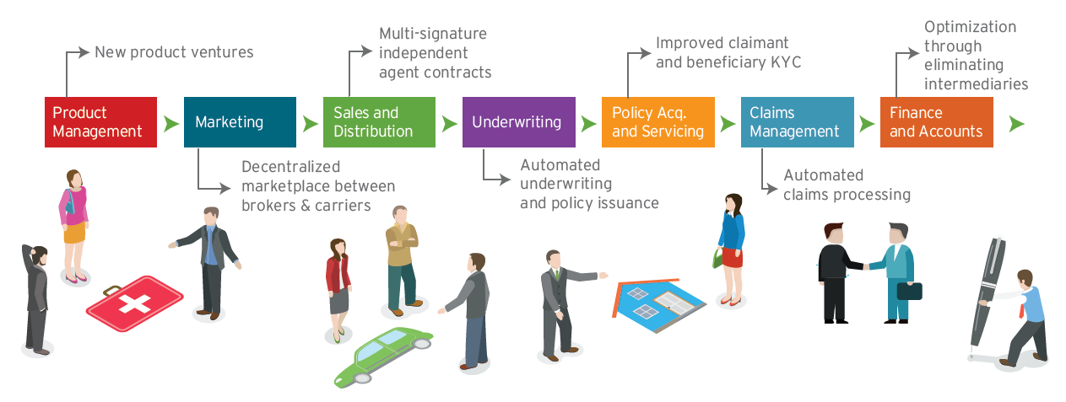
Blockchain’s Role in Insurance
Notes:
Blockchain can be leveraged across the insurance value chain due to its ability to offer long-term strategic benefits such as lower operational costs in the form of reduced duplication of processes, reduced counterparty risks, increased automation of processes, and secure and decentralized transactions

Slide 3
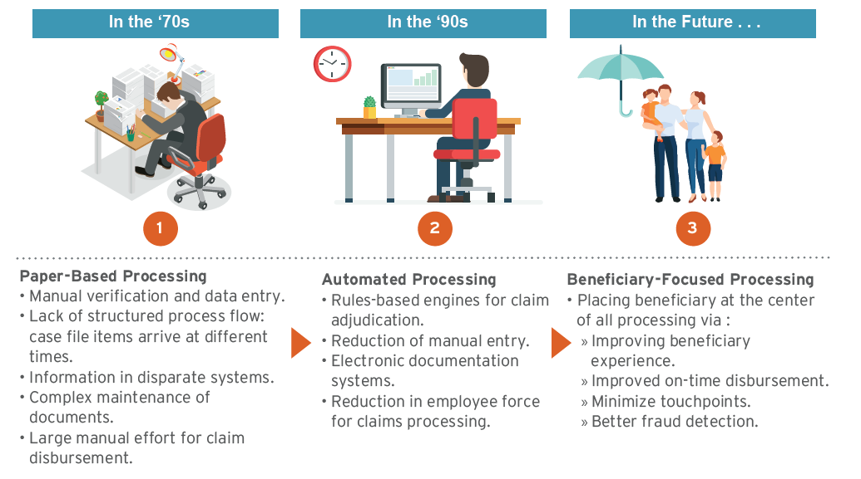
Claims Processing Yesterday & Tomorrow

Slide 4
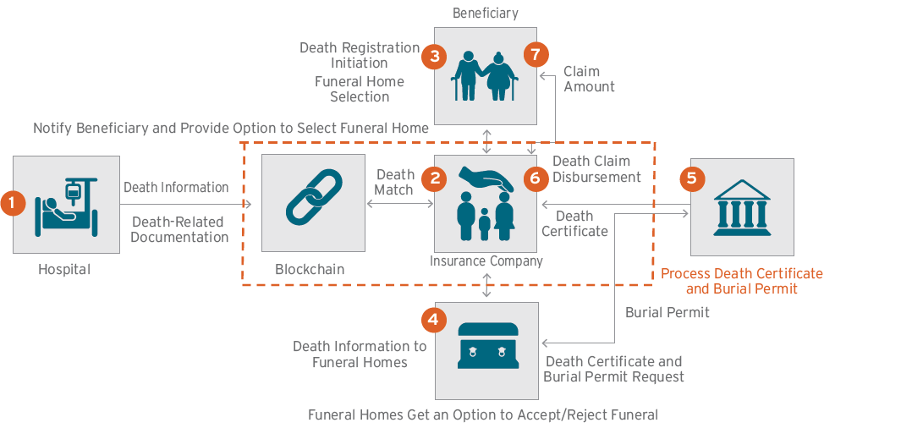
Blockchain in Claims

Slide 5
Feasibility & Implications
Feasibility
Data Protection and Security
Enablement of multiparty shared network
Disintermediation
Unified Streamlined Process
Potential Implications for Life Insurers
Reduced Turn Around time: The turnaround time of the entire death claims processing is significantly reduced
No hassles to beneficiary: The beneficiary is not burdened with collecting death-related documents, submitting cumbersome forms or following up with the insurer for the disbursement of the claim amount. Death registration and claims are initiated and processed by the various entities in the network.
Reduction of fraudulent claims: All the records are available on a public ledger and can be audited at any point in time with easy traceability.
Enhanced scalability: The solution can be scaled to include multiple entities (including regulatory bodies, additional insurers or hospital networks) and thereby expand the reach of the insurer.

Slide 6
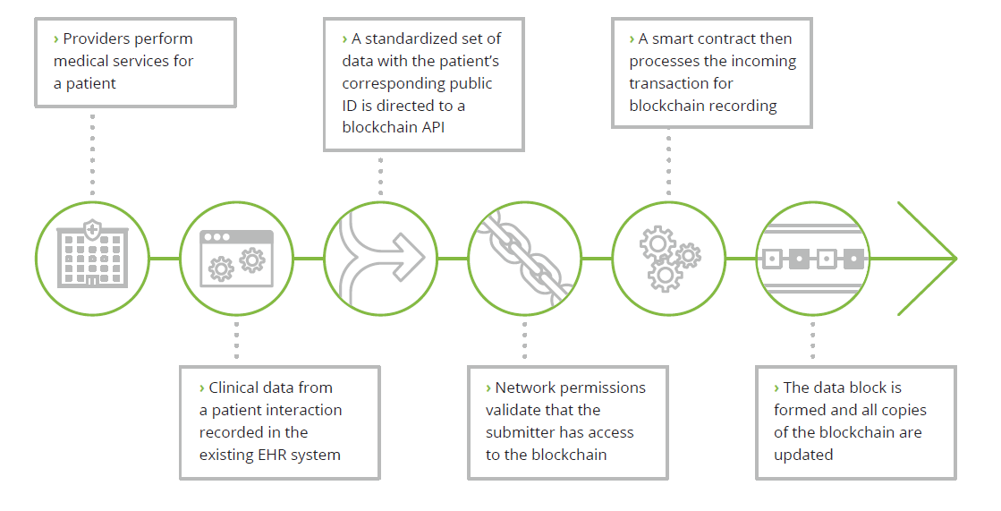
Adding Medical Data to Blockchain

Slide 7
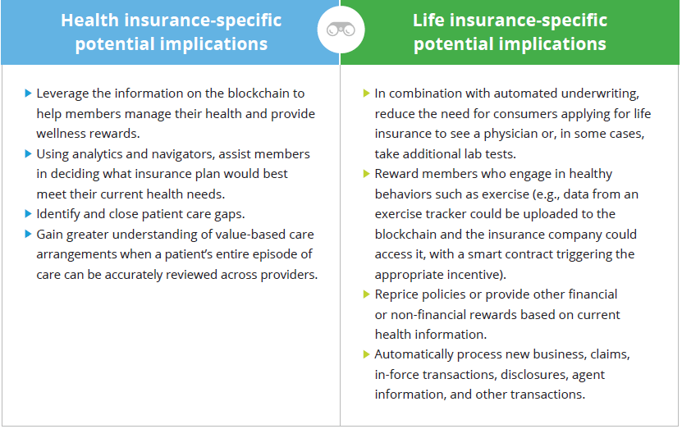
Feasibility & Implications

Slide 8
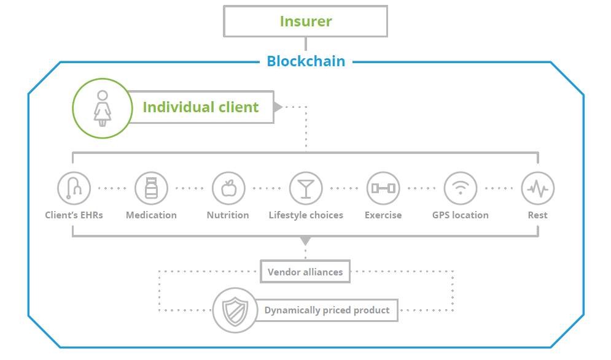
Facilitating Dynamic Insurer Client Relationship

Slide 9
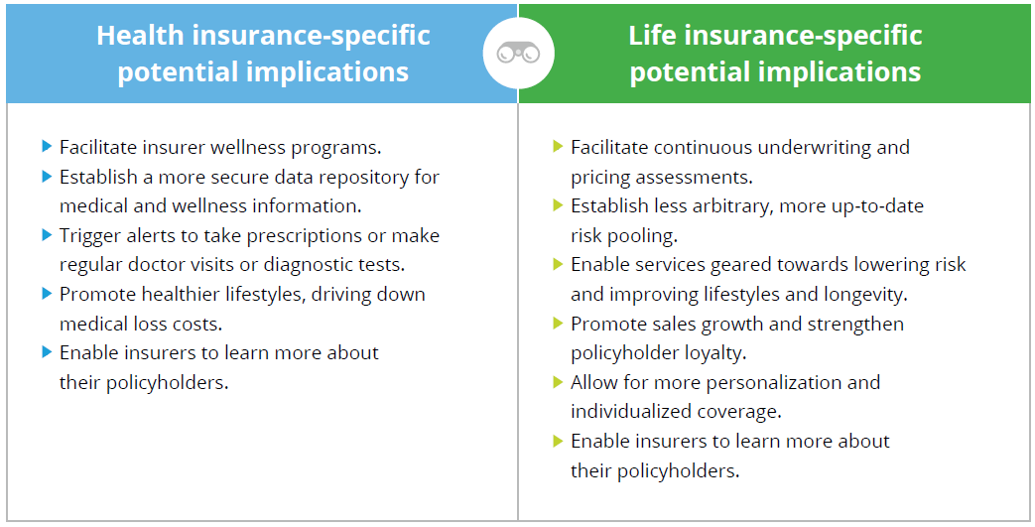
Feasibility & Implications

Slide 10
Implementation Options
Blockchain used in tandem with the existing claim management system: Many insurers have claims processing systems that could be integrated via application program interfaces (APIs) and controlled by event-based triggers in smart contracts. In one scenario, the death registration process could be carried out completely on the blockchain, while the policy match and claim processing could be handled on existing systems, with information passed via APIs.
Blockchain as a stand-alone solution: The stand-alone solution would have the death registration, health data, policy match and claim processing logic present on the blockchain. Data could be fed to prewritten and agreed-upon contractual states saved as smart contracts. The solution could use a secondary distributed database system, such as IPFS, to support larger data objects, with their addresses hashed and stored on the blockchain.

Slide 11
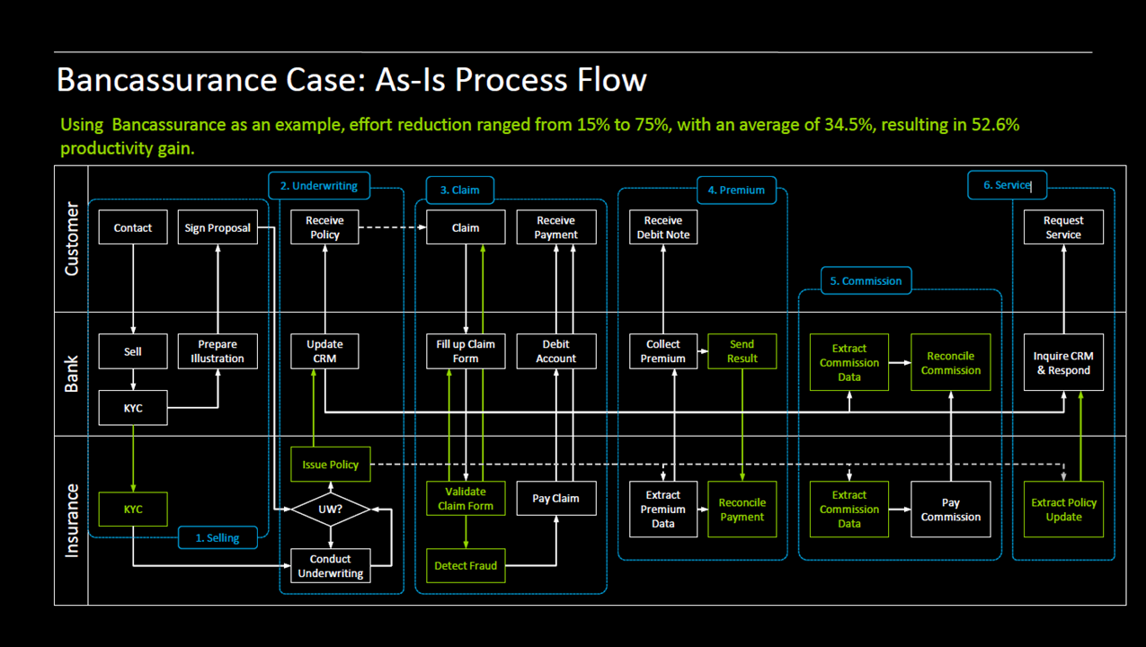

Slide 12
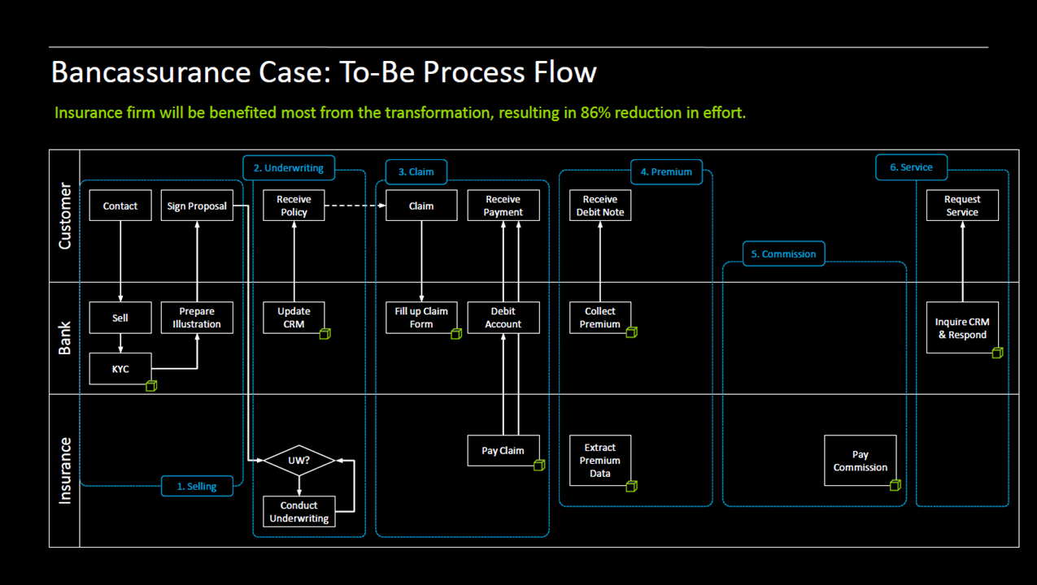

Slide 13


Oracle Strategy: Most Comprehensive, DLT Cloud Platform
Enterprise-Ready
Permissioned, highly secure, with built-in privacy/confidentiality
Scalable business networks
Highly resilient, built-in backups and recoverability
Industry neutral
Quick Time-to-Value
Start develop applications within minutes
API driven development
Facilitate quick experimentation of new business processes
Managed PaaS for Cloud & On-Prem
Pre-assembled, ready-to-use
Dev/Integrators focus on transaction business logic
Dynamic configuration, expansion of business networks
Extending Enterprise Boundary
Built-in Integrations for SaaS, PaaS and on-premises apps
Securely extend ERP, SCM and other business processes for trusted transactions with other organizations
Interact with other Blockchain Networks
13

Slide 14
Oracle Value Proposition
 | Oracle Non Blockchain specific services (used in conjunction with distributed ledger scenarios)
 | Hyperledger Fabric
 | Blockchain specific cervices
Value at different levels
Capabilities to surround or be consumed by underlying blockchain distributed ledger platforms
e.g. Rules, Policy, Document Mgt
Blockchain Partner Applications
Application Integration
3rd Party distributed Open source Hyperledger
Blockchain Implementation (Platform)
Blockchain Application Implementations platforms themselves
e.g. Digital Trade Chain (DTC)
Blockchain Ledger (Software)
Blockchain Infrastructure
Blockchain services & Tools (upon which a specific blockchain implementation can be deployed/maintained).
i.e., Blockchain Cloud Service
Common & Integration Services API, Integration and data movement
e.g. Platform Services
Compute Infrastructure
Applications connected to block chains
e.g. ERP Application, Trade Finance Applications
Computing resources : Infrastructure as a Service
Notes:
Am still trying to get my head round what product mgt are up to in terms of our core blockchain offer, but in a nutshell they appear to be targeting simplifying the deployment of certain types of blockchain (hyperledger based blockchains) – so
making it simpler for an organisation to deploy and operate
making it simpler for a multi actor (consortium)
It should appeal to our FS customer (at least those using Hyperledger based blockchains)
We could still play a role in nonHyperledger based blockchains but unlikely at the blockchain level (would be an above and below play for them)
Points to note
If you’re wondering why there is a “graduated” colour in there, that’s because there are multiple software implementations of blockchain tech out there, some open and some proprietary and we don’t provide support for them all (but even the ones we don’t support like Corda we could run on IaaS and the applications on top could still consume oracle be integrated with Oracle etc).
Deck on use cases to follow in a couple of weeks – I have asked my team to pull together specific scenarios related to the banks and insurers they work with so we keep it real / avoid the hypotheticals.
Right now in FS we tend to see mainly permissioned blockchains (where groups/consortiums of Banks are getting together to solve a problem with other banks, regulators and other orgs like land registries and cases like Trade Finance, Letters of credit, Mortgages (Property Valuations), Reference Data etc
We are not seeing to many permission-less “bitcoin” / Etherium ones (at least coming out of banks)
We are now seeing interest from a handful EMEA customers e.g. HSBC, ING, Generali, Credit Agricole etc
We have some Startups, ISVs and Fintechs also in the Blockchain area (so plays might be to them as well as banks)

